Slide 1
Science as Nationalist Discourse in Colonial Korea
Deven Toothman

Slide 2
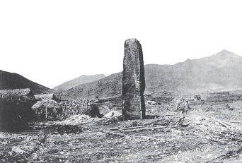
Gwanggaeto Stele

Slide 3
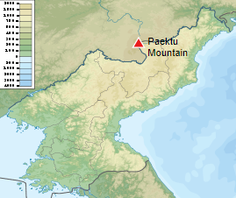
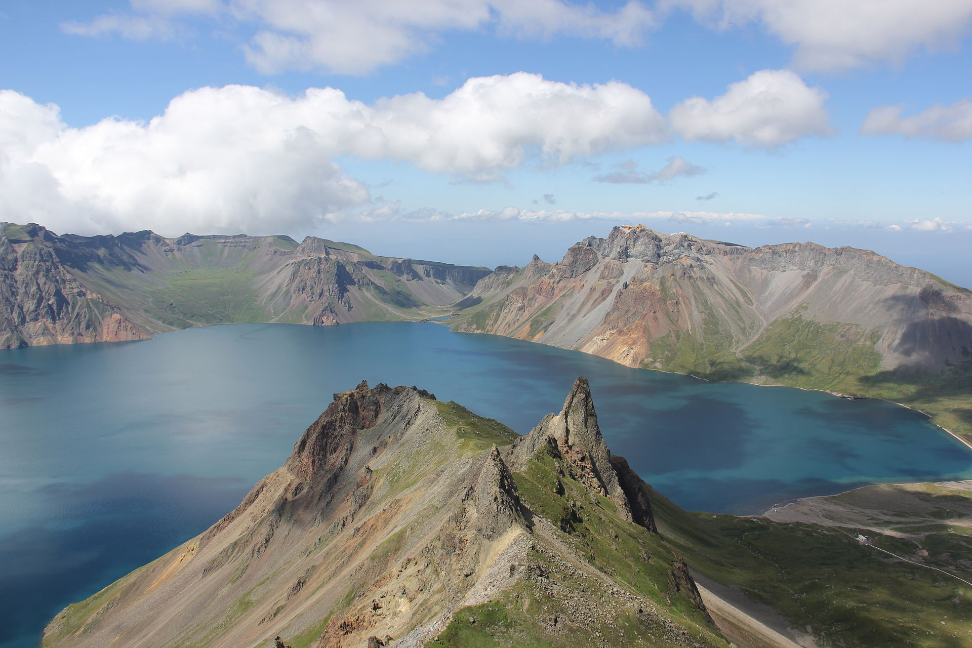
Geomancy/P’ungsu
Parallel concepts of territoriality -geomancy and administrative demarcation
Nationalist publications detangle the concepts
“old knowledge”/ “old custom” kuhak/kusŭp
Rejection of Chinese influence
Unproductive
New maps in textbooks

Slide 4
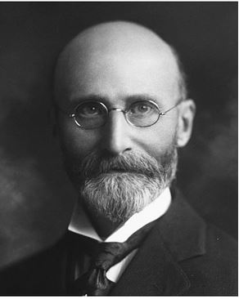
Neurosis
Medical missions, and the ‘disease of civilization’
Japanese doctors and colonial hospitals
Neurasthenia and hysteria
Western doctors in the colonial period
Took Korean neurosis seriously
Korean doctors
Traditional Korean medicine
Civilization hypothesis reinterpreted

Slide 5
Psychosis
Internal medicine vs psychiatry
Young professionals distinguishing Psychosis from Neurosis
By who?
For who?
Psychoanalysis
Newspaper publications

Slide 6
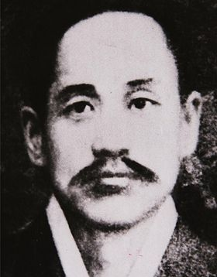
Pan-Asianism and Racial Categorizations
Capital Gazette-Hwangson sinmun
Sin Chae-ho and minjok

Slide 7
Sources
“Korea Between Empires: 1895-1919”, 2002. Schmid, Andre
“Distinguishing between neurosis and psychosis: discourses on neurosis in colonial Korea” from History of Psychiatry 2022, Vol. 33(3) 350-363. Sihn, Kyu-hwan

