Slide 1
Japan’s Atom Physics in Early 20th century

Slide 2
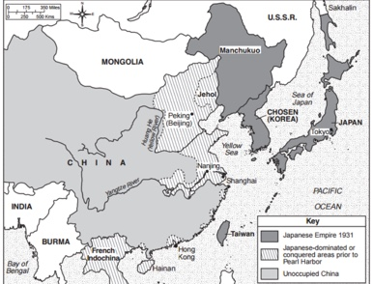
Motivation for scientific research investment
Inter-War:
Domestic military technology
the Anglo-French blockade of Germany
- Since the Meiji Restoration: national goal = to rise as an equal of Western powers
The aims of science must be subsumed under the national good.
(“value of knowledge seemed to be based on practical utility”)

Slide 3
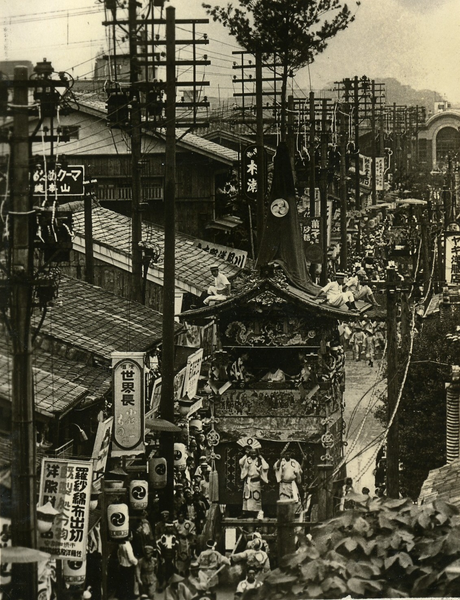
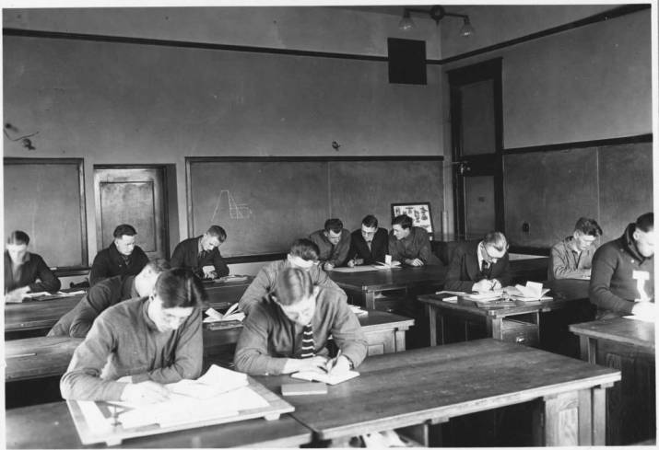
Electrical engineering
Perceived as valuable knowledge in early 20th century
Electrification progressed after the Russo-Japanese War
(Telegraph network,…)

Slide 4
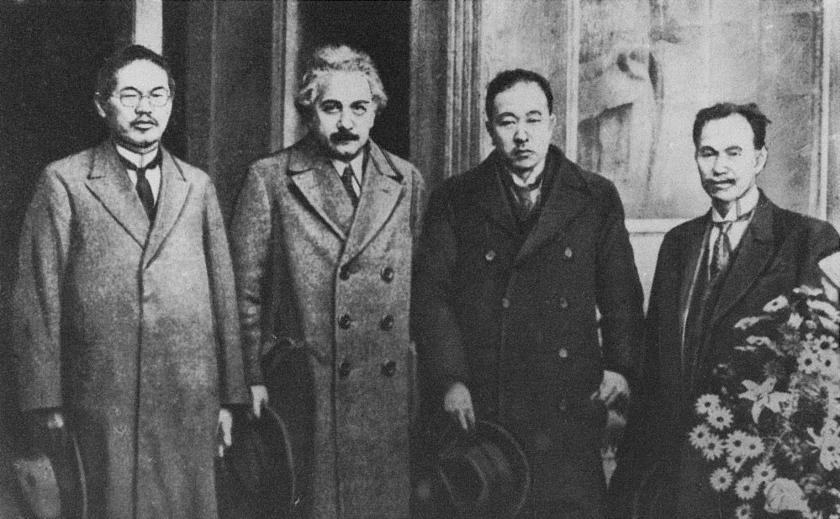
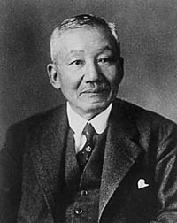
Atom Physics
Gradual rise in first three decade of the twentieth century
Funding Agency
1932: Establishment of the Japan Society for the Promotion of Science (日本学術振 興会).
Denshiron --- "discourse on the electron"
Denshi = electron
----> claim its value to electrical engineering
From left to right: Kotaro Honda, Albert Einstein, Keiichi Aichi and Shirota Kusakabe
Hantaro Nagaoka
Toshinojo Mizuno

Slide 5
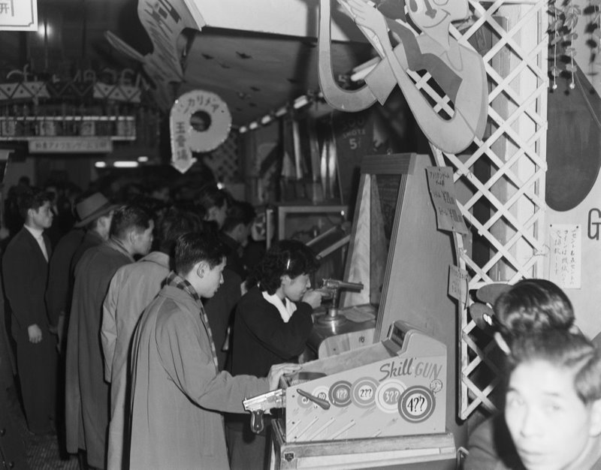
Technocracy
a movement by the technical elite to ensure their power in the government.
Kojin Club: 1920, a group of young engineers from Tokyo Imperial University.
Science for the empire?

Slide 6
Bibliography
Bartholomew, James R., “Japan,” in Modern Science in National, Transnational, and Global Context, ed. Hugh Richard Slotten, vol. 8, The Cambridge History of Science (2019), 555–76.
Ito, Kenji. “‘Electron Theory’ and the Emergence of Atomic Physics inJapan.” Science in Context 31, no. 3 (2018): 293–320.

