Slide 1
Ismail Gasprinski and ideology for Progress in Muslim Spaces
Science and the Nation
Liza Zolotarova _ 2022

Slide 2
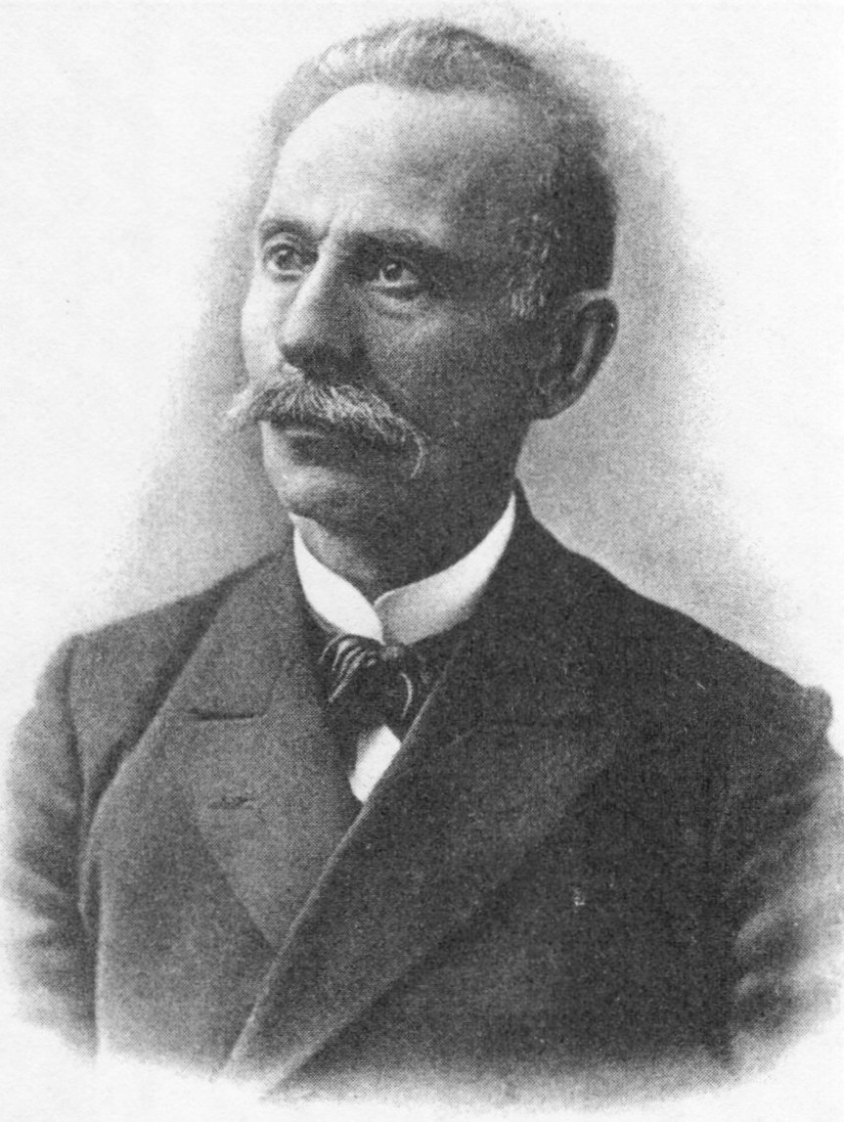
Ismail Gaspirinski and Terjuman
اسماعيل غصپرينسكى
1851-1914, Crimea
Simferopol, Voronezh, Moscow, France, Turkey
1905 Alem-i Nisvan
Terjuman is closed on February 23, 1918

Slide 3
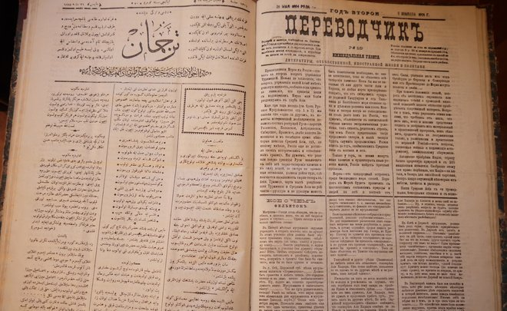

Slide 4
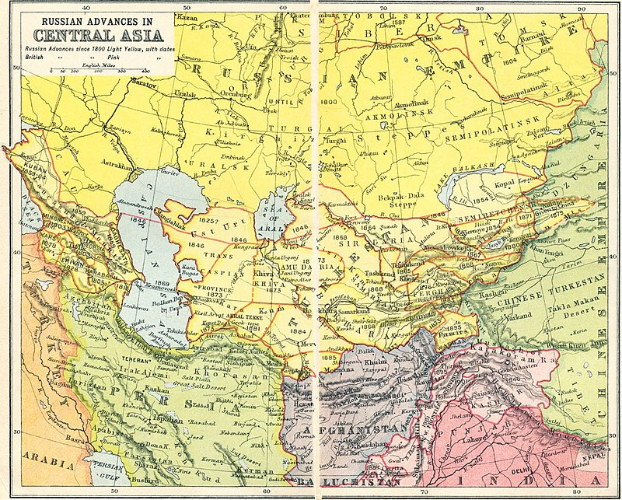
Influence of Gasprinski in Turkestan
Transfer of the Russian modernist thought to Turkestan
Adjusting concepts and methods formed in a non-Islamic context to the needs and demands of Muslim cmmunities

Slide 5
Dar-ur Rahat and Usul-u Jadid
Frengistan mektüpları (Molla Abbas mektüpları), Dar ür rahat müslümanları, Kadınlar ülkesi, Afrika mektüpları
Comparison of “Frengistan” and “Turkestan”
General welfare among people
Women position. Roles of genders
Technology
Settlers’ schools and medrese – 1.primary schools; 2. mass education of adults through periodical press and new Muslim literature
1884 First new methods school in Crimea
Was cadidist ideas his creation?
“a mental-cultural movement, fostering mental awakening, and direction muslims’ movement towards the European culture, restructuring of the society in accordance with the modern needs”
“reconciliation of Islam with the modernity”

Slide 6
Friendship between Slavic and Turkic peoples, rejection of socialists’ demands and ideas
Returning to “pure Islam”
Kadimists
“In the spirit of Sharia”
«Самый многочисленный и главный народ России — русские — одарены весьма редким и счастливым характером мирно и дружно жить со всякими другими племенами. Зависть, враждебность, недоброжелательство к инородцам не в характере обыкновенного русского человека. Это хорошая черта, несомненный залог величия и спокойствия России…»
— Терджиман 1884. № 1 (8 января). С. 1.

Slide 7
Further Fate of His Idea
Fikirde, dilde, işte birlik – Unity in work, language, and work
Mükaleme-i selatin (1906-07) – Gatherting of the rulers
Lack of unity, sthlosness,
1905 – World Muslims Summit in Cairo
Related figures:
Ziya Gökalp, Ahmet Mithat Efendi, Usein Tohtargazi, Asan Sabri Ayvazov, Mahmudhoca Behbudi, Abdurauf Fitrat
Pan Turkism and Pan Islamism?
A bourgeoisie movement?

Slide 8
Sources
"Исмаил Гаспринский и Туркестан в начале XX века: связи – отношения – влияние", 2011. Зайнабдин Абдирашидов
“Полное собрание сочинений Исмаила Гаспринского“ 2016. Simferopol
Addeb Khalid. The Politics of Muslim Cultural Reform: Jadidism in Tsarist Central Asia. Ph.D. diss. University of Wisconsin0Madison

