Slide 1
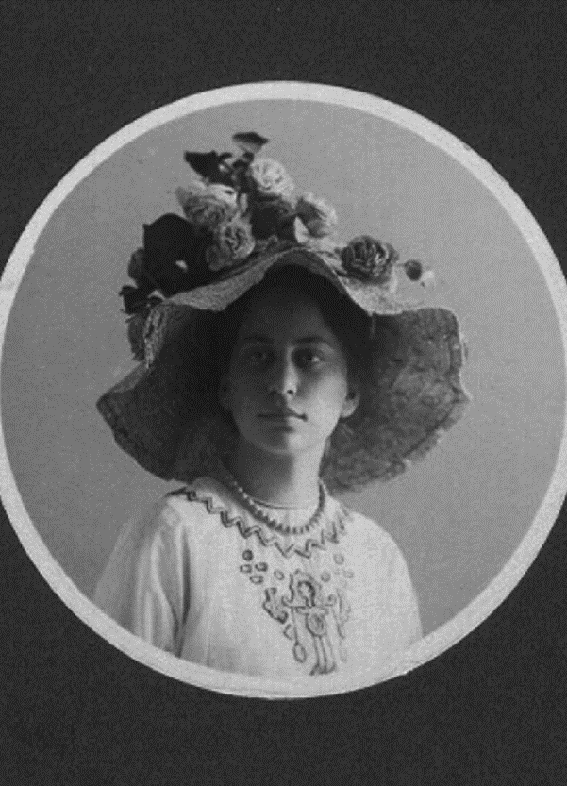
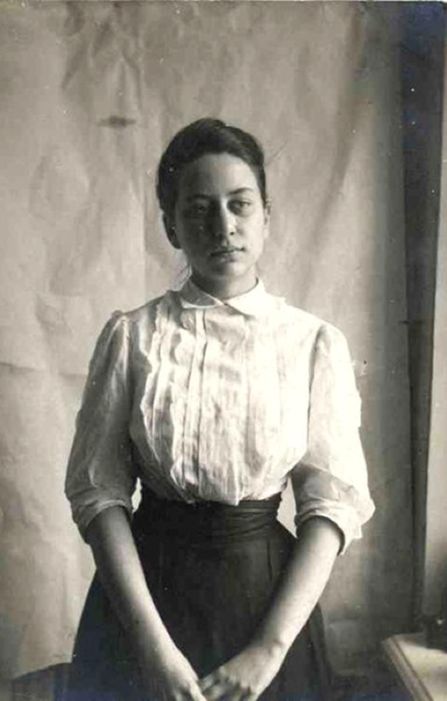
Olga Freidenberg (1890–1955), classical philologist

Slide 2
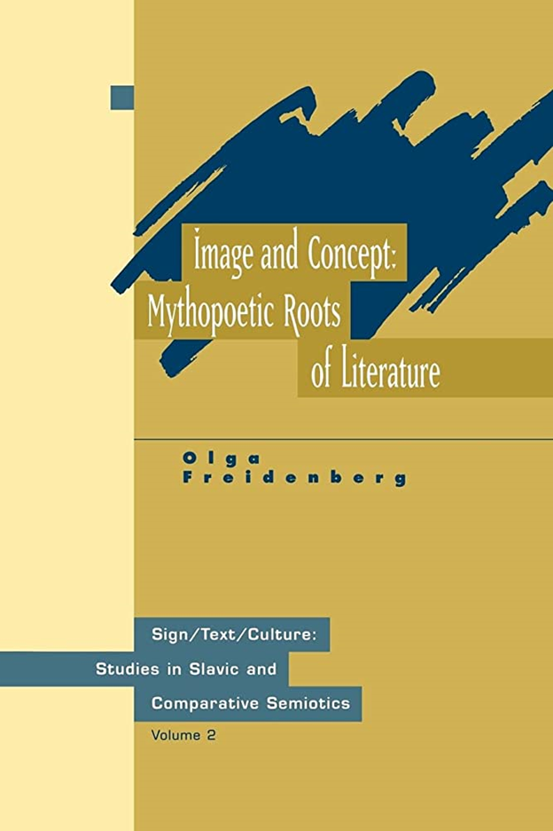
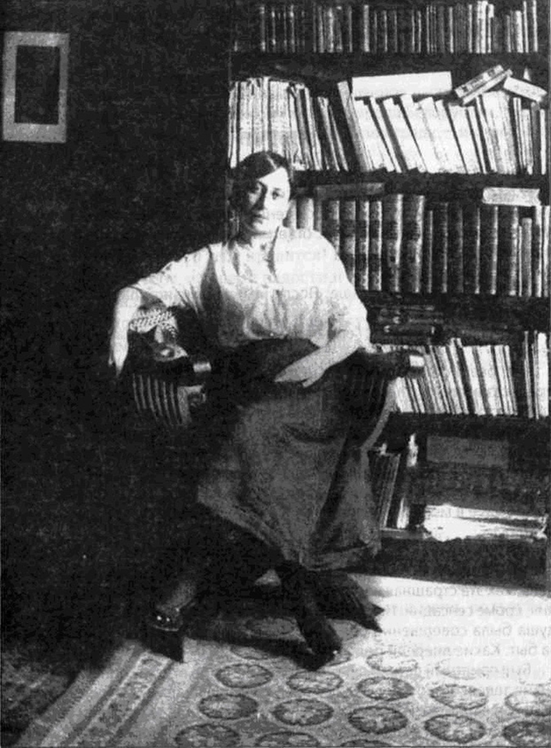

Slide 3
E-archive of Freidenberg's works

Slide 4
Пробег жизни - Life's mileage
The main part of the notes is the chronicle of the Leningrad siege
The diary was consciously written from the perspective of an anthropologist
It is the document not only of the life in an extreme situation, but also of total politicisation
The notes elaborated a political theory of the state, referencing to Plato, Aristotle and Hobbes
Freudenberg built her political theory from within the totalitarian state, and in some respects she thought differently from her counterparts

Slide 5
Citizens! During shelling this side of the street is the most dangerous

Slide 6
Пробег жизни - Life's mileage
The main part of the notes is the chronicle of the Leningrad siege
The diary was consciously written from the perspective of an anthropologist
It is the document not only of the life in an extreme situation, but also of total politicisation
The notes elaborated a political theory of the state, referencing to Plato, Aristotle and Hobbes
Freudenberg built her political theory from within the totalitarian state, and in some respects she thought differently from her counterparts

Slide 7
Hanna Arendt

Slide 8
Пробег жизни - Life's mileage
The main part of the notes is the chronicle of the Leningrad siege
The diary was consciously written from the perspective of an anthropologist
It is the document not only of the life in an extreme situation, but also of total politicisation
The notes elaborated a political theory of the state, referencing to Plato, Aristotle and Hobbes
Freudenberg built her political theory from within the totalitarian state, and in some respects she thought differently from her counterparts

Slide 9
Purges in Leningrad University

Slide 10
The importance of Freidenberg's notes
"Written by someone who lived during the era of Hitler and Stalin, the notes also reflect the weary mind of the exhausted author. And therein lies their value as a document - a testimony of the era and its terrible pressure on man. It is hardly an exaggeration to say that Freudenberg's notes constitute one of the most remarkable human documents of the 20th century".

