Slide 1
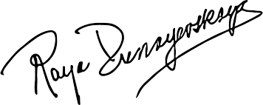
Raya Dunayevskaya Ра́я Дунае́вская
1910, Vinnytsia Oblast – 1987, Chicago

Slide 2
Life
1922
Emigrated to the U.S.
1928
Expelled from the American Communist Party
1937
Moved to Mexico for Trotsky interpreter
1939
Broke with Trotsky
1940
Up to c. 1953:
Socialist Workers Party
Workers Party
1955
News and Letters Committees
News & Letters
1958
Marxism and Freedom: From 1776 Until Today
1973
Philosophy and Revolution
1982
Rosa Luxemburg, Women's Liberation, and Marx's Philosophy of Revolution

Slide 3
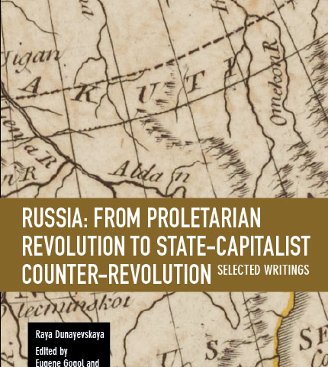
Trotskyism

Slide 4
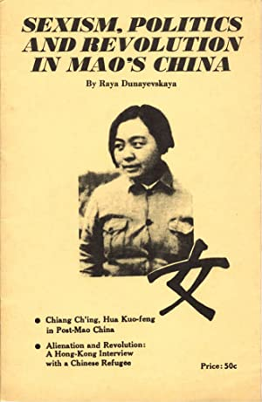
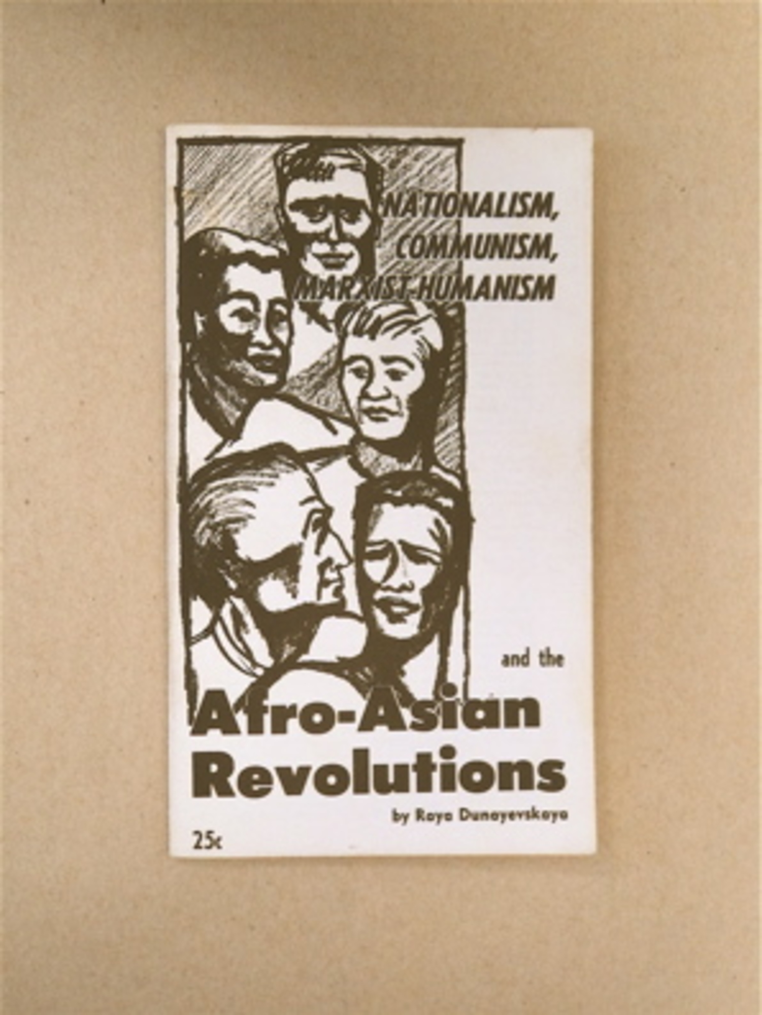
Feminism and the Third World

Slide 5
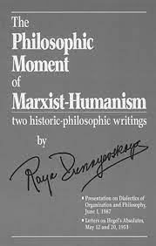
Marxist Humanism

Slide 6
Thank you

