Slide 1
Sex and the revolution
Visions of Revolutionary sexuality
f. Berkant yavuz

Slide 2
„The western poetic ideal o f romantic love, the tortures and delights, “sighs and tears and pale wanderings,” have little appeal for the Bolshevik. If two comrades are in love, they go to the home of one of them. “
Ella Winter, in Red Virtue
“What has free love done for Russia? Every woman can be a legalized prostitute. Homes are wrecked, the joys o f the fireside with the children’s mirth when at play arc gone. Everybody does as he or she likes. The woman, who is your wife today, may be another man’s wife tomorrow. “
Royal Baker, in The Menace Bolshevism*

Slide 3
Revolutıonary puritanism and zalkınd’s twelve commandments (1924)
Sexual life shall not develop too early among the proletariat.
Thou shalt exercise sexual restraint until marriage, and marriage shall take place only upon full social and biological maturity (20-25 years).
Sexual relations shall be the culmination of a deep and comprehensive sympathy and attachment to the object of thy sexual love.
The sexual act shall be the final link in a chain of deep and complex experiences binding the lovers together at that moment.
The sexual act shall not be repeated often.
Thou shalt not often change thy sexual object. There shall be less sexual variation.
Love shall be monogamous and monoandrous (one wife, one husband).
Every sexual act must be committed without forgetting the possibility of conceiving a child – thou shalt always remember thy progeny.
Sexual selection shall always be conducted along the lines of revolutionary-proletarian class objectives. Elements of flirtation, skirt-chasing, coquetry, and other particular methods of sexual conquest must not be introduced into love relations.
Thou shalt not be jealous.
Thou shalt not engage in sexual perversions.
In the interest of revolutionary expedience, class shall have the right to interfere in the sexual life of its co-members; the sexual shall always be subordinate to class interests, never interfering with the latter, but shall always serve it.

Slide 4
Platonov’s “antı-sexus” (1926)
“No document characterizes the epoch of the bourgeoisie’s living decay, its utter moral atrophy, better than the one appended below. […] Even though we’re ready for anything these days from the warmongering bereaucrats and capitalist, fascist fat cats […] we never thought they could be so completely devoid of sense and lacking in basic tact.”
Anti-Sexus, Prologue
“Our company has transformed sexual feeling from a crude elemental urge to an ennobling mechanism, we have given the world moral behavior. We have removed the element of sex from human relationships and cleared the way for pure spiritual friendship.”
Anti-Sexus, main body

Slide 5
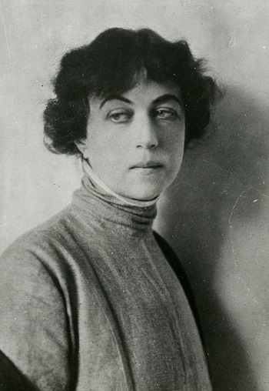
Kollontaı and Love-comradeshıp
“New mankind will have to find new words to express those multiformed nuances of emotions, since those used now only in coarse form render such states as love, passion, amorousness, friendship. All the numerous half-tones, the entire complex pattern of the soul, composed of the meshing of these various feelings are absolutely not conveyed by these stiff concepts and obscure definitions.”
“The ideology of the working class […] is clearing the way toward a recognition of the value of love as a psycho-social force.”
from “Make Way for the Winged Eros”, 1923 in Molodaia Gvardia

Slide 6
Epılogue: Kollontai versus the Zhenotdel and the Molodaya Gvardia

Slide 7
Source material
Carleton, Gregory. 2004. Sexual Revolution in Bolshevik Russia. University of Pittsburgh Pre.
KollontaI, Aleksandra. 1980. Selected Writings of Alexandra Kollontai. Norton.
Platonov, Andrei. 2016. “The Anti-Sexus.” Stasis 4 (1). https://stasisjournal.net/index.php/journal/article/view/125.
Rosenberg, William G. 1990. Bolshevik Visions: First Phase of the Cultural Revolution in Soviet Russia. University of Michigan Press.
Schuster, Aaron. 2016. “One or Many Antisexes? Introduction to Andrei Platonov’s ‘The Anti-Sexus.’” Stasis 4 (1). https://doi.org/10.33280/2310-3817-2016-4-1-20-35.

