Slide 1
A Week Like Any Other
Double Burden in the Soviet Union

Slide 2
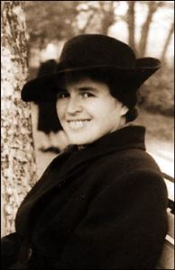
Natalya Baranskaya
Natalya Vladimirovna Baranskaya (Russian: Наталья Владимировна Баранская; January 31, 1908 – October 29, 2004
Неделя как неделя, 1969
Отрицательная Жизель, 1977
Цвет темного меду. Платье для госпожи Пушкиной, 1977
Женщина с зонтиком, 1981
Портрет, подаренный другу. Очерки и рассказы о Пушкине, 1982
День поминовения, 1989

Slide 3
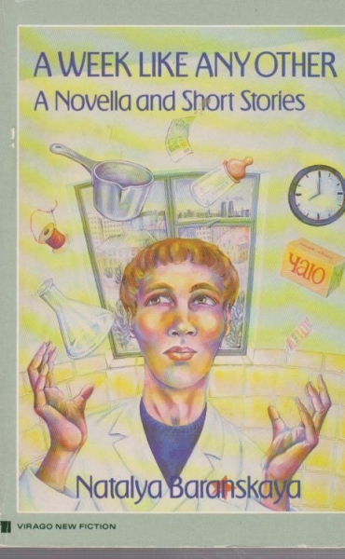
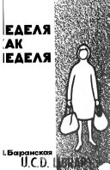
A Week Like Any Other (Неделя как неделя)
First published in 1969
Translated to English in 1971 and again in 1974 (the edition used here)
The plot:
A normal week (like any other) in the life of a Soviet woman, who works in a lab and has two kids, told from Monday to Sunday

Slide 4
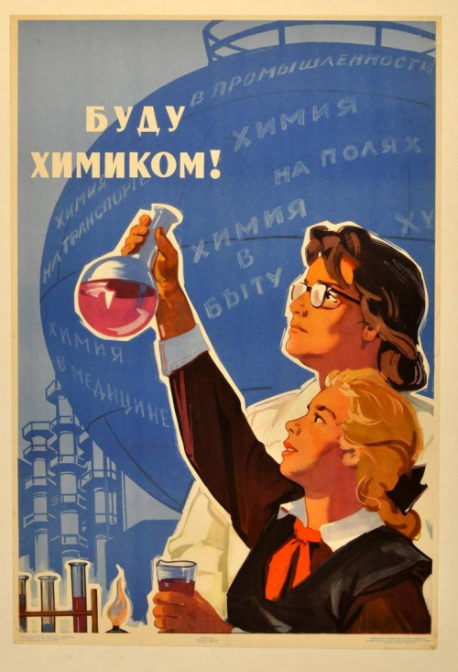
At work
Propaganda poster, 1964

Slide 5
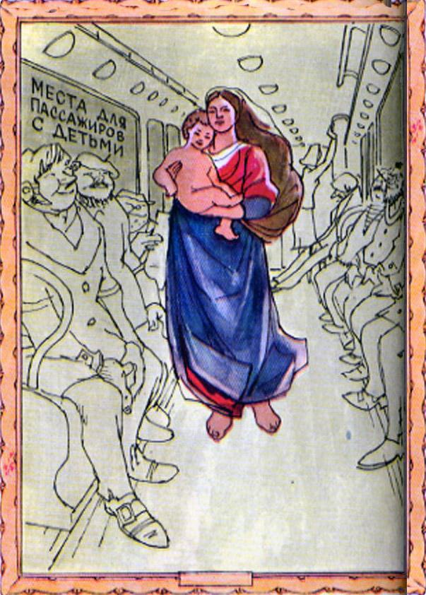
Commuting

Slide 6
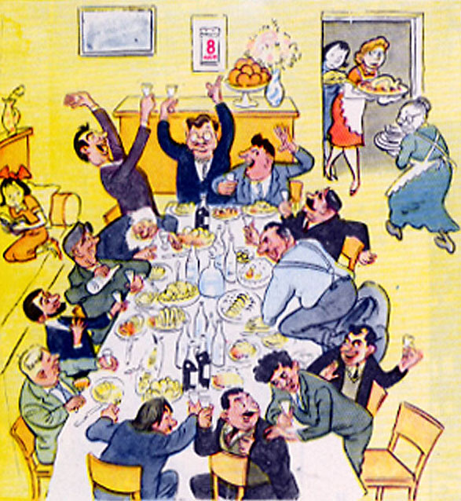
At home: double burden

Slide 7
Questionnaire for Women
Point 3: "Composition of your family: husband ... children under 7 years of age . . . children from 7 to 17 . . . other relatives living with you."
"What do your children attend: nursery school, extended day school."
"in the given period of time how many hours do I spend on "a) housework, b) child care, c) leisure.* Leisure: radio and television, movies, theatre, etc., reading, sports, tourism, etc."
"Days excused from work on account of illness: yours, your children's (the number of workdays for the past year; we ask you to give the information based on the time-sheet)”

Slide 8
Contradictions:
On the other:
Pay gap
No recognition for the double burden
The fact that the author herself seems wary of “Western feminist interpretation of the story”
On one side
Several women with graduate degrees working in STEM
Access to daycare
Abortion care

Slide 9
Bibliography:
Alpern-Engel, Barbara. “Women and state”. The Cambridge History of Russia, Volume III - The Twentieth Century, edited by Ronald Grigor Suny. Cambridge University Press, Cambridge, United Kingdom, 2006, pp. 468-494.
Donert, Celia. “Feminism, Communism and Global Socialism: Encounters and Entanglements.” The Cambridge History of Communism, edited by Silvio Pons et al., III, Cambridge University Press, Cambridge, United Kingdom, 2020, pp. 399–421.
Francisca de Haan (ed.), “Ten Years After: Communism and Feminism Revisited,” Aspasia 10 (2016), 102–68.
Nanette Funk, “A Very Tangled Knot: Official State Socialist Women’s Organisations, Women’s Agency and Feminism in Eastern European State Socialism,” European Journal of Women’s Studies 21 (2014), 344–60;
Kristen Ghodsee, “Untangling the Knot: A Response to Funk,” European Journal of Women’s Studies 22 (2015), 248–52;

