Slide 1
“[T]his thing we call art exists in order to restore the sensation of life, in order to make us feel things, in order to make a stone stony. The goal of art is to create the sensation of seeing, and not merely recognizing, things; the device of art is the “enstrangement” of things and the complication of the form, which increases the duration and complexity of perception, as the process of perception is, in art, an end in itself and must be prolonged. Art is the means to live through the making of a thing; what has been made does not matter in art.”
Viktor Shklovsky, “Art as Device” (1917)

Slide 2
"...the law of associations is destined to become predominant in experimental psychology, to remain for a time at least the last explanation of mental phenomena. It is thus destined to play in the world of ideas a role analogous to attraction in the world of matter. It is only surprising that this discovery is so late. Meanwhile it is easy to notice that this law of associations is the main and irreducible phenomenon in our psychic life, that it lies at the basis of all our actions. This law admits of no exceptions: neither sleep, nor delirium, nor mystic ecstasy, nor the most abstract reasoning outside of it, are possible. To detain it would be tantamount to suspending thought itself.”
Theodule Ribot, Essai sur l'imagination créatrice (1900)

Slide 3
“Poetry lifts the veil from the hidden beauty of the world, and makes familiar objects be as if they were not familiar. […] ...it purges from our inward sight the film of familiarity which obscures from us the wonder of our being. It compels us to feel that which we perceive, and to imagine that which we know. It creates anew the universe, after it has been annihilated in our minds by the recurrence of impressions blunted by reiteration.”
Percy Bysshe Shelley, “The Defence of Poetry” (1821)

Slide 4
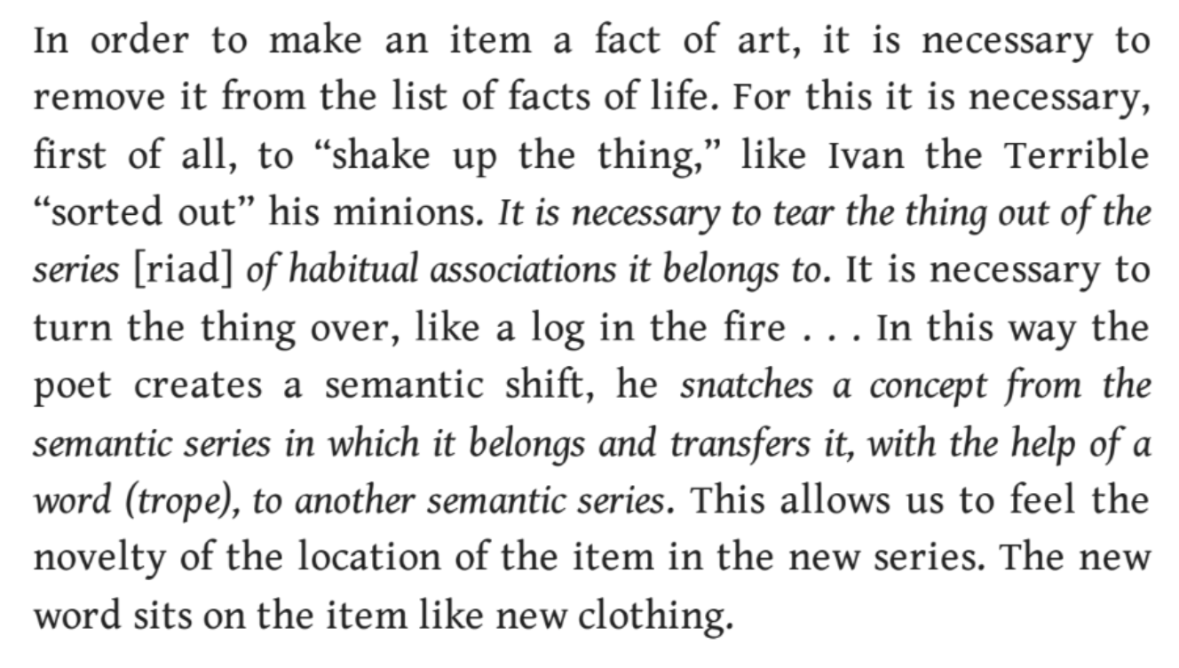
Viktor Shklovsky, On the Theory of Prose (1925)

Slide 5
Bibliography:
Ilona Svetlikova, The Roots of Russian Formalism: The Tradition of Psychologism and the Formalist School (Moscow: NLO, 2005).
Jessica Merill, The Origins of Russian Literary Theory: Folklore, Philology, Form (Evanston: Northwestern University Press, 2015).

