Slide 1
Freudianism and its interpretations:
Curious case of Edmund Bergler and his legacy

Slide 2
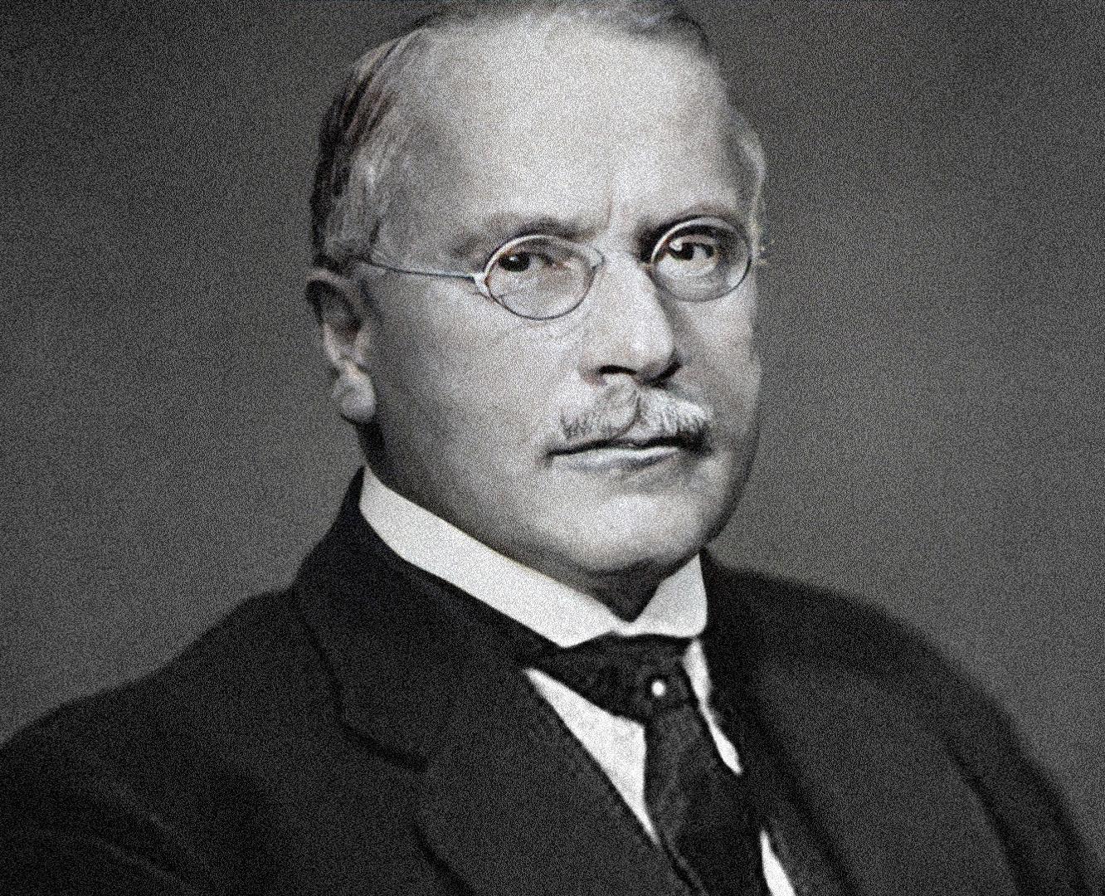
Edmund bergler: short biography
Born in 1899 in Jewish family. Most sources state simply that he is “Austrian born”, but actually he was born in Kolomyia (current Ukraine)
Family moves to Vienna in 1913, Edmund gets drafted during WW1
In 1917, after returning from the war, becomes a medical student in the University of Vienna, in 1926 becomes an intern.
1933-35 worked as a leading specialist in the Vienna Psychoanalytic Union hospital
In 1938 left Ausria with his wife and immigrared to France and, later, to the US. Got an American citizenship in 1943

Slide 3
“The essence and significance of science of Professor Sigmund Freud” (1924)
How does this article from a medical student in Vienna ends up in a Soviet periodical, founded in Ukrainian Kharkiv?
The answer: frankly, it is still a bit of a mystery from the preliminary research into his biography
My own leading theory: Bergler was involved with his local “Sozialistische Gesellschaft für Sexualberatung und Sexualforschung” (Socialist society for sex counseling and sex research) starting from 1928, so quite possibly the article was published through his socialist connections

Slide 4
What is the article about?
Bergler attempts to systematize and review Freud’s theories and his explanation on how neurosis works, while additionally showcasing that some of the more “scandalous” assumptions have legitimate ground in psychology
He starts out by explaining Freud’s theories on phases of sexual development in children and supplementing them with observations and anecdotes about children getting to understand their bodies and the reproductive system
Bergler also notes how sadism and masochism as well as various neurosis form as behaviorist habits at different stages get interrupted during the formation of an individual’s sexuality, citing Freud’s Oedipal complex and “penis envy” theory
He then moves to a discussion of the unconscious and the meaning of dreams from the psychoanalytical standpoint and how important it is to interpret them correctly
Lastly, he discusses Freudian notions of how hysteria is caused by displacement in a person’s life and one should differentiate between a “fear neurosis” and “true neurasthenia”
He concludes by saying that Freudian analysis is a necessary tool for any practicing psychoanalyst and researchers should combat attempts to trivialize Freud’s teachings

Slide 5
An excerpt about the meaning of dreams
“…the king and the queen imitate the sleeping person’s parents, the prince or the princess – the sleeper themself. All the objects that have elongated shapes: sticks, tree trunks, vipers, umbrellas can represent a male member (due to their similarity to an erect one). Boxes, crates, shelves, ovens, carts symbolize the body to the woman. Rooms in the dream are mostly female. (…) A dream in which one walks out of a room fast is a harem dream. Tables, set tables, and desks represent women. All complicated machines and devices represent, perhaps, sexual organs. Landscapes often signify women's sexual organs; the country “where one has been already” symbolizes the body of the mother. Children often signify genitalia, since both men and women, when they are grown, can their private parts “small” [ed: here he refers to a Ukrainian word “малий”, which means small, but can also be used to refer to children]…”

Slide 6
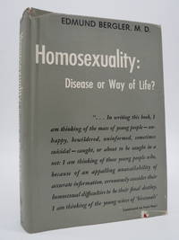
But what is bergler really famous for?
Edmund Bergler is considered one of the most loyal students and followers of Freud’s works and Freudianism as such
He published 27 books (24 of them in English) and over 300 articles in the course of his academic career
His contemporaries considered him one of the most important theorists of homosexuality in the 50s
Bergler’s work on masochism was also considered noteworthy
So why is he now mostly forgotten?

Slide 7
Bergler’s homophobic legacy
Bergler, like Freud, considered homosexuality a disease, although he vehemently disagreed with the latter about the innate bisexual nature of humans and had a well-known feud with Alfred Kinsey and famously rejected his scale
Unlike Freud, however, he often described gay people in very negative terms, stating they have a low moral character and are erroneously victimized in contemporary society
More importantly, he believed that homosexuality can be “cured completely” by employing and stated that he personally have cured around 100 and consulted over 500 gay people
His efforts contributed significantly to the rise of the conversion movement in the United States
“I can say that with some justification that I have no bias against homosexuals; for me they are sick people requiring medical help.” But did he really have no bias?

Slide 8
