Slide 1
How Soviets lost their heads from experiments

Slide 2
What is “New Man”? (Krementsov 2021)
Final stage in the knowledge operation
the production of new knowledge
translation into accessible language
uses by a variety of interested parties → New Man
Fighting broadness with case study

Slide 3
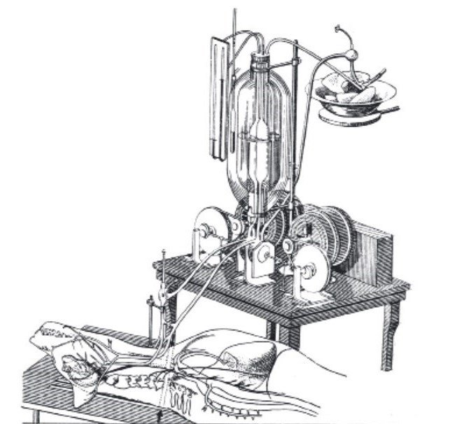
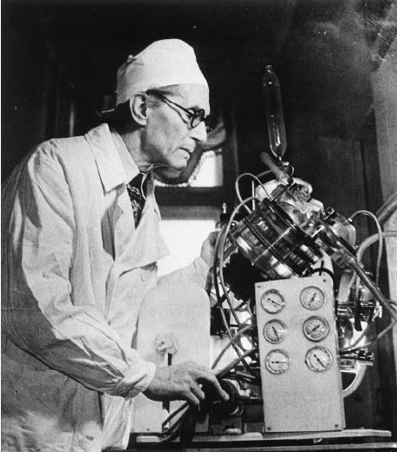
Sergei Bruikhonenko (1890-1960): experiments with dogs
Autojecor - Cardiopulmonary bypass
Diagram of artificial blood circulation of the dog's brain using an autojector
Notes:
https://archive.org/details/Experime1940

Slide 4
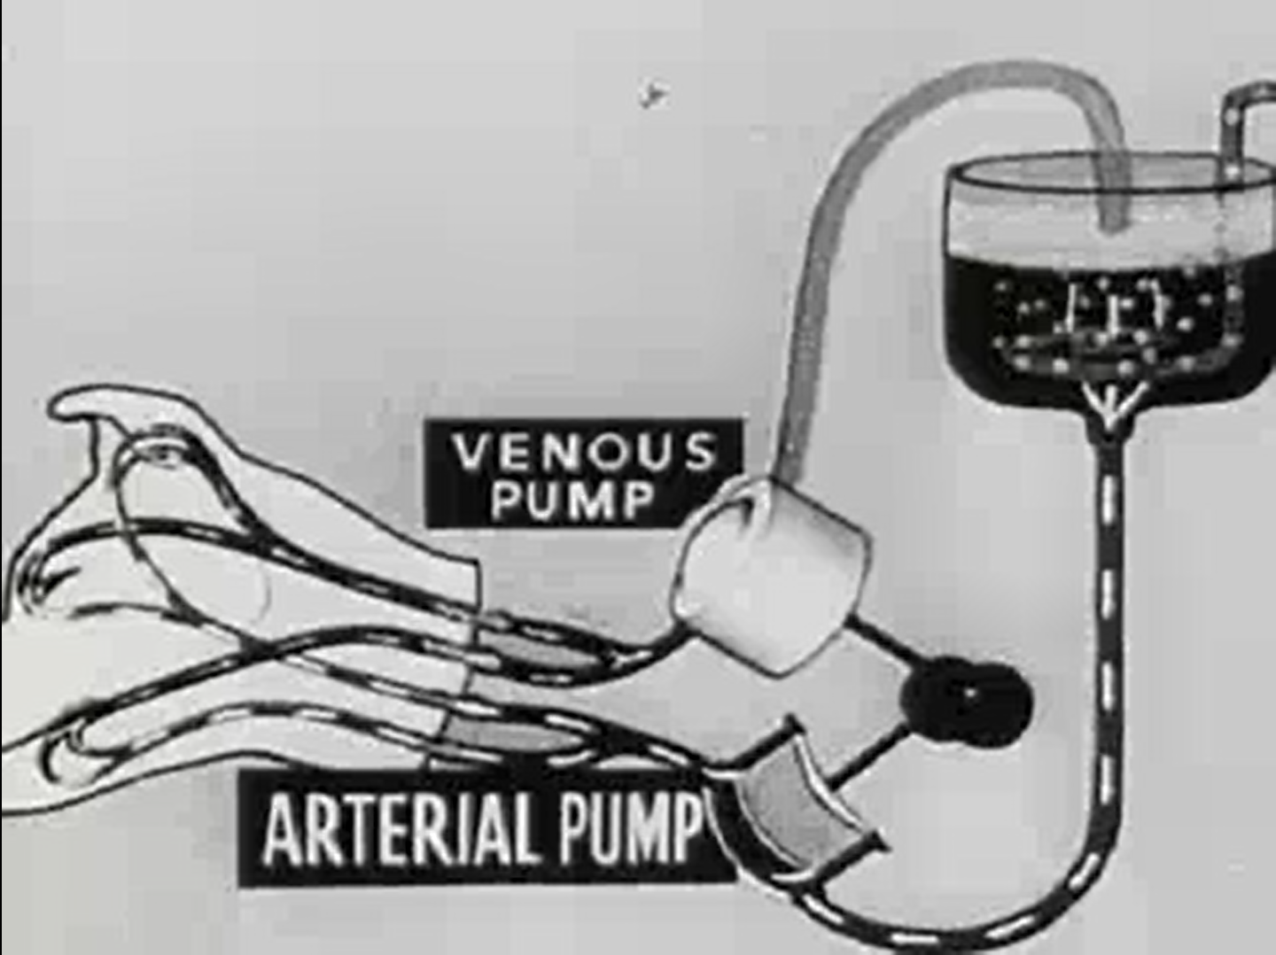
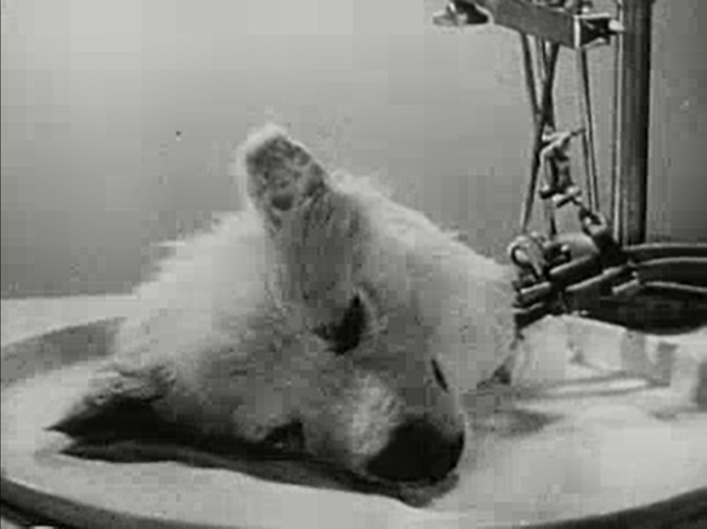
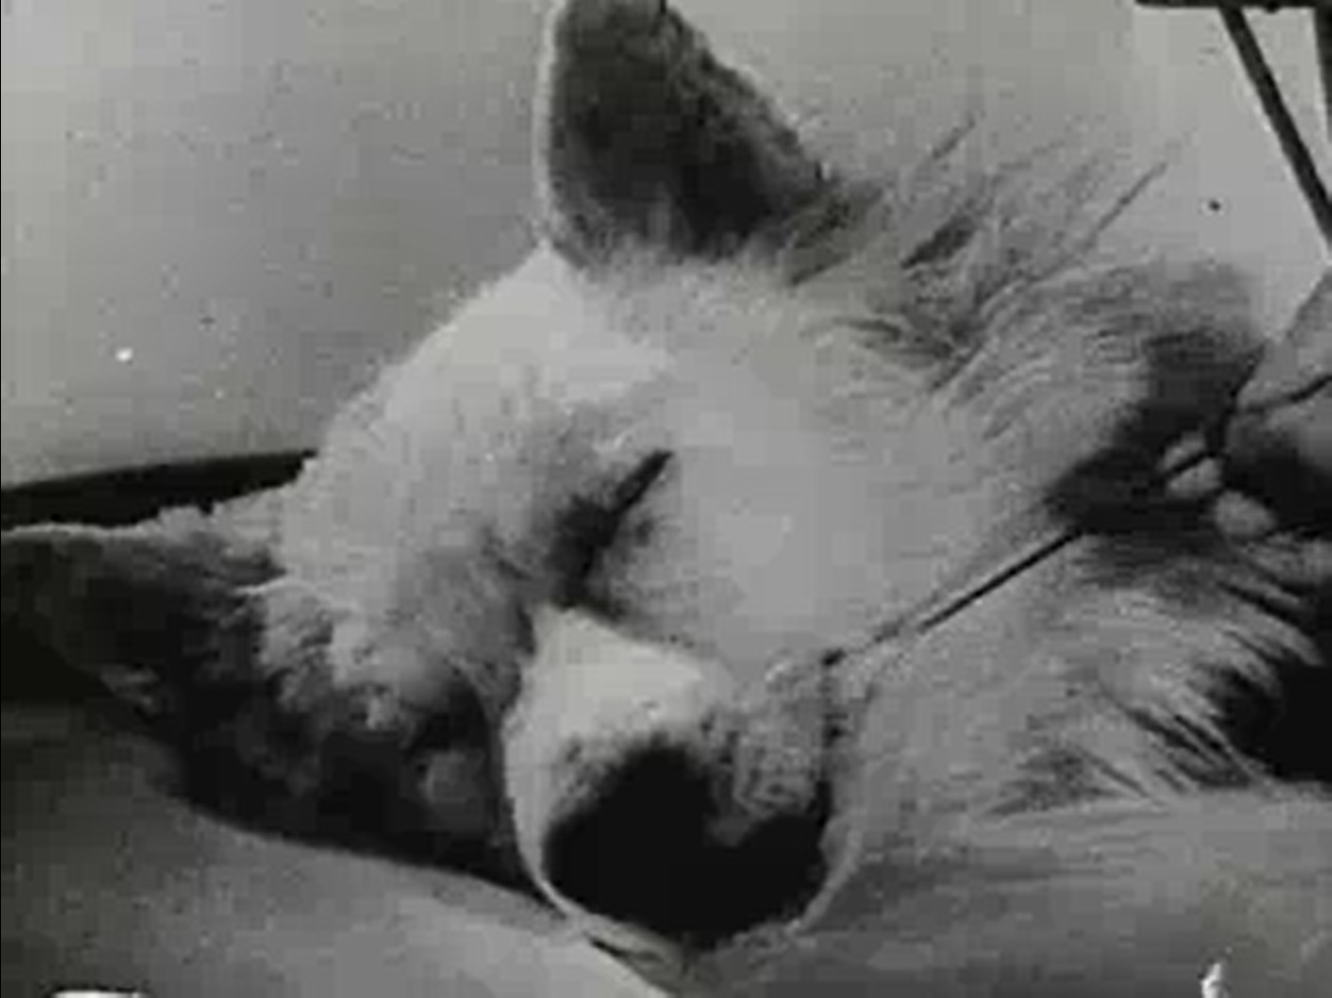
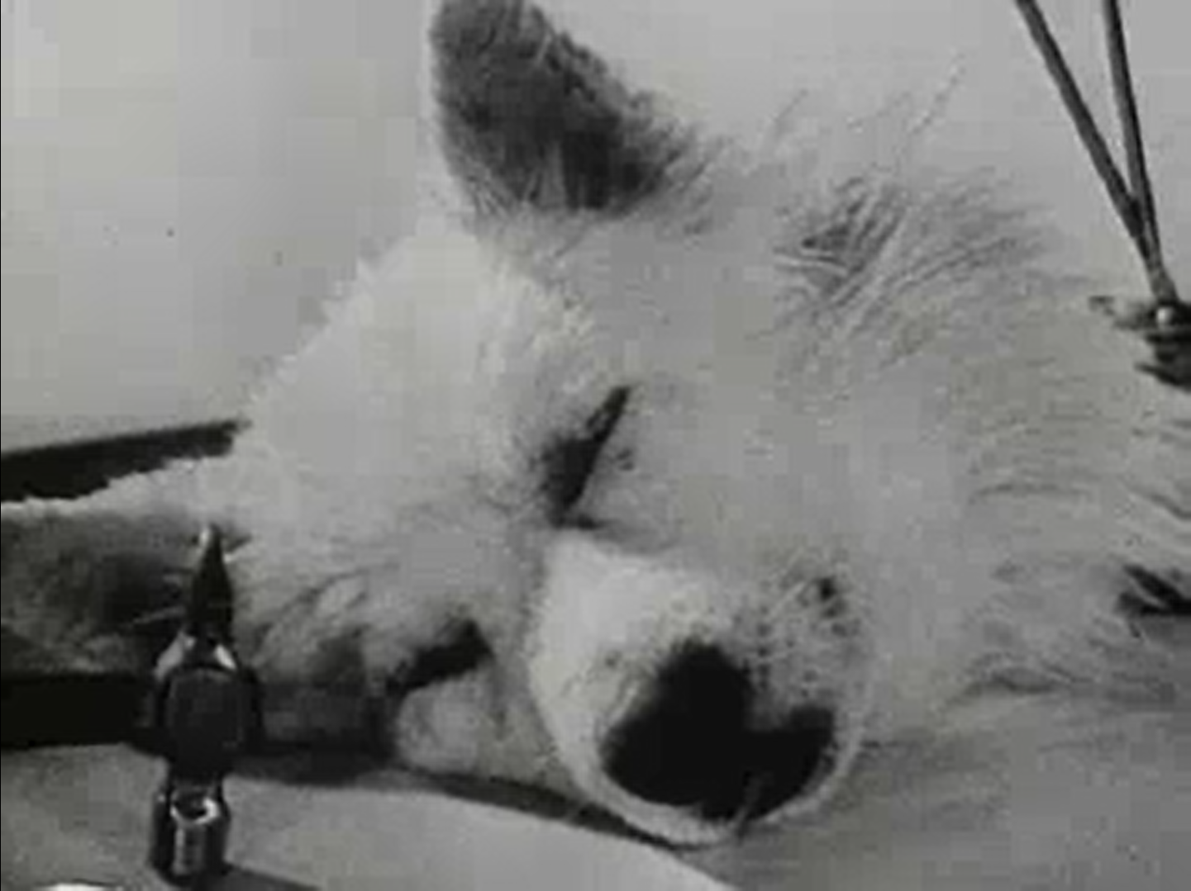
Sergei Bruikhonenko (1890-1960): experiments with dogs

Slide 5
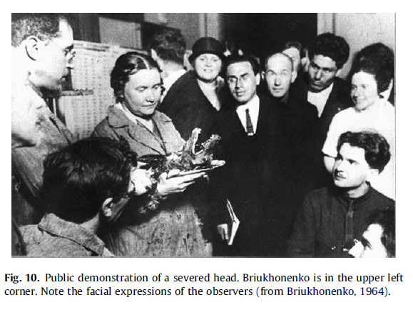
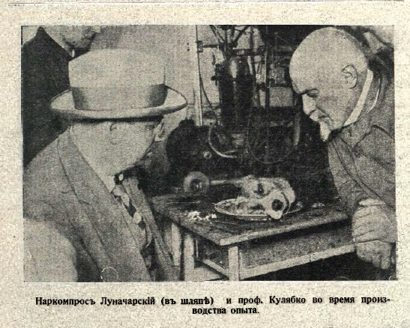
Substitution of lungs and heart with the machine “Resurrection” of dogs
From Kremenstov 2009
Cover of the magazine Sparks of Science (May 1928)
Commissar of Enlightment Anatolii Lunacharskii and Professor Kuliabko during an experiment, Illustrated Russia (1929)

Slide 6
Knowledge production. Motivations
Collective and personal trauma (WW1, Civil War, Epidemics)
alternative explanations behind Marxism and religious thinking
“Understand or rationalize the unjustified sufferings” (Kozhevnikov 2022, p. 280)
European influence
“European ideas as either a major inspiration, as an invitation to respond with a substantial commentary, or sometimes simply as a fashionable allusion”(Kozhevnikov 2022, p. 277)
Who did own revolutionary experimental thinking?
Did scientists manifest cynical death mindset?

Slide 7
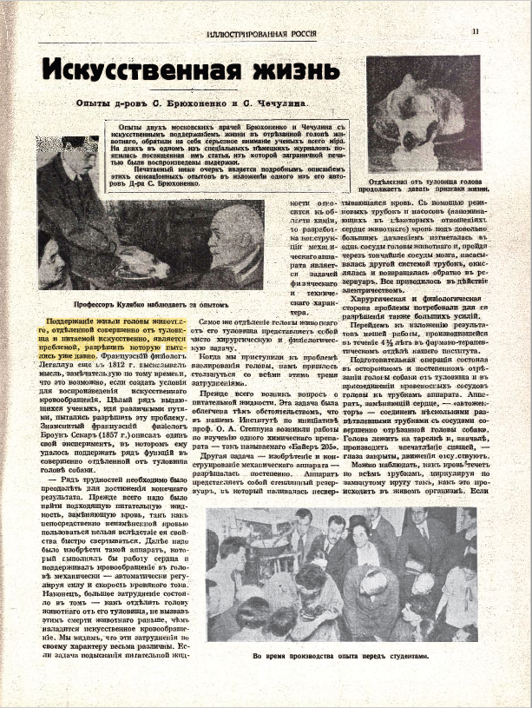
Public science. Dissemination
Scientific problem or death manipulation?
“Maintaining the life of the head of an animal, completely separated from the body and fed artificially, is a problem that has long been tried to be solved.”
Sergei Brukhoneno, “Artificial life,” Illustrated Russia (May 1928)

Slide 8
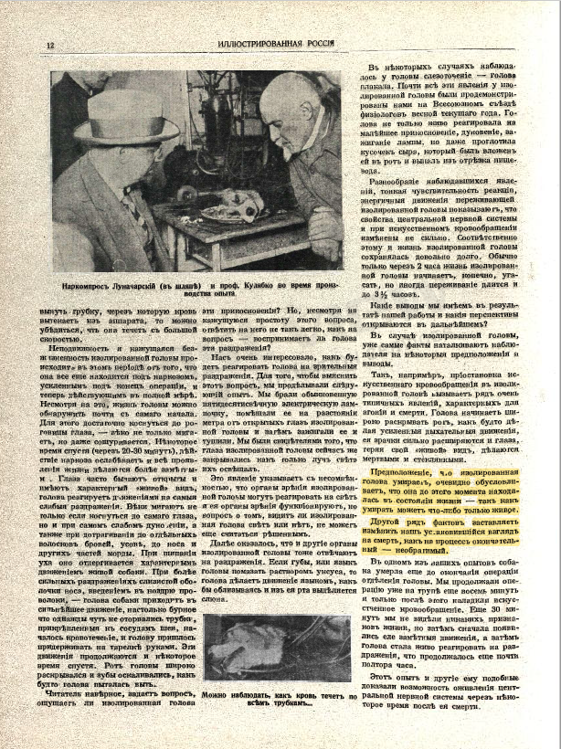
Public science. Dissemination
Scientific problem or fight with death?
“The assumption that the isolated head dies obviously determines that up to this moment it has been in a state of life, since anything can die only alive.”
“Another series of facts forces us to change our established view of death as a final, irreversible process.”
Who is scientists?
Sergei Brukhoneno, “Artificial life,” Illustrated Russia (May 1928)

Slide 9
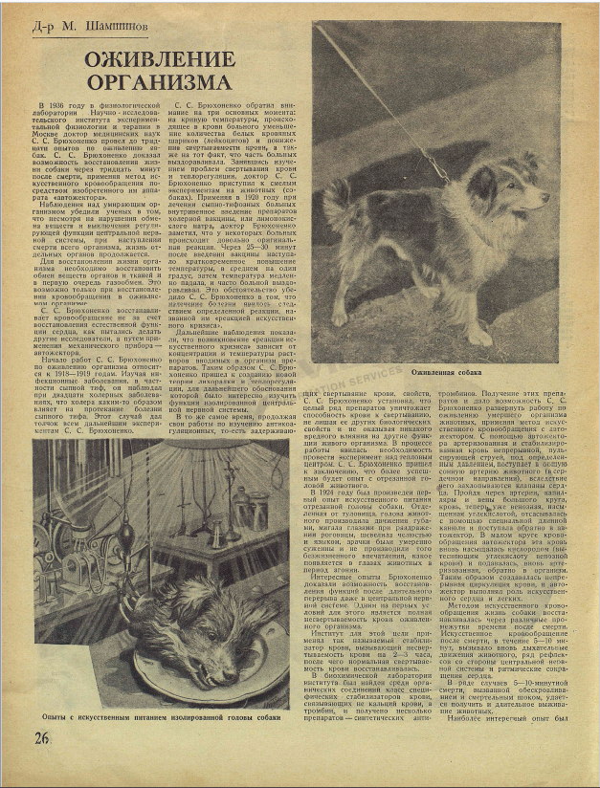
How to represent scientist?

Slide 10
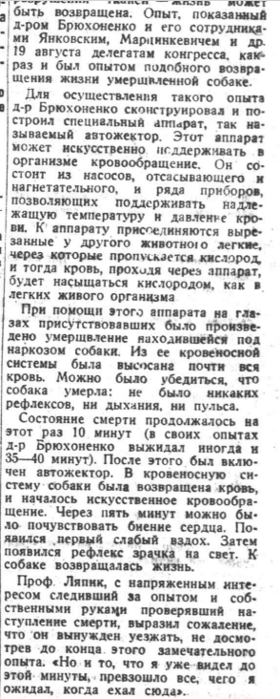
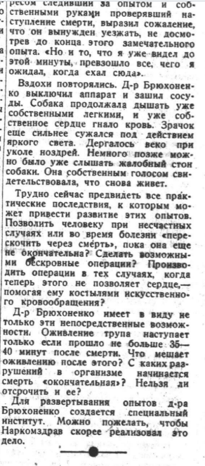
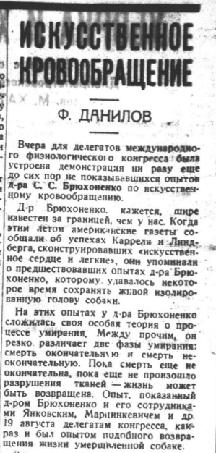
Public science. Usage
Scientist is the contributor to the industrial production
“It is difficult now to foresee all the practical consequences to which the development of these experiments may lead. To allow a person, in case of accidents or in time of illness, to skip over death, while it is not yet final? Make bloodless operations possible?”
F. Danilov, "Artificial blood circulation,“ Izvestiia (1935)

Slide 11
Bibliography
Krementsov, Nikolai. "Off with your heads: Isolated organs in early Soviet science and fiction." Studies in History and Philosophy of Biological and Biomedical Sciences 40, no. 2 (2009): 87-100.
Krementsov, Nikolai. “New sciences, new worlds, and ‘New Men’,” in The Art and Science of Making the New Man in Early 20th-Century Russia, edited by Yvonne Howell and Nikolai Krementsov (2021).
Kojevnikov, Alexei, “Space-Time, Death-Resurrection, and the Russian Revolution,” in Science, Technology, Environment, and Medicine in Russia’s Great War and Revolution, 1914–22, edited by Anthony J. Heywood, Scott W. Palmer and Julia A. Lajus (2022)

