Slide 1
The Origins of Eugenics in the Soviet Union & Germany around the 1920s
Brooklyn Hortenstine
Soviet Intellectuals
26 January 2023

Slide 2
Terms and Distinctions
Positive Eugenics: Positive eugenics encourages the healthiest populations to continue having children and passing on traits, without necessarily impacting the ‘unfit’ directly.
Negative Eugenics: Negative eugenics focuses on the eradication of the ‘unfit’ through certain measures, most commonly through isolation and/or involuntary sterilization
Lamarckism: The belief that inherited characteristics can later be passed down to offspring through genetics.
Questioning of The Descent of Man: Should Darwin’s theories be used against humans?

Slide 3
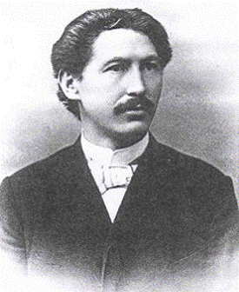
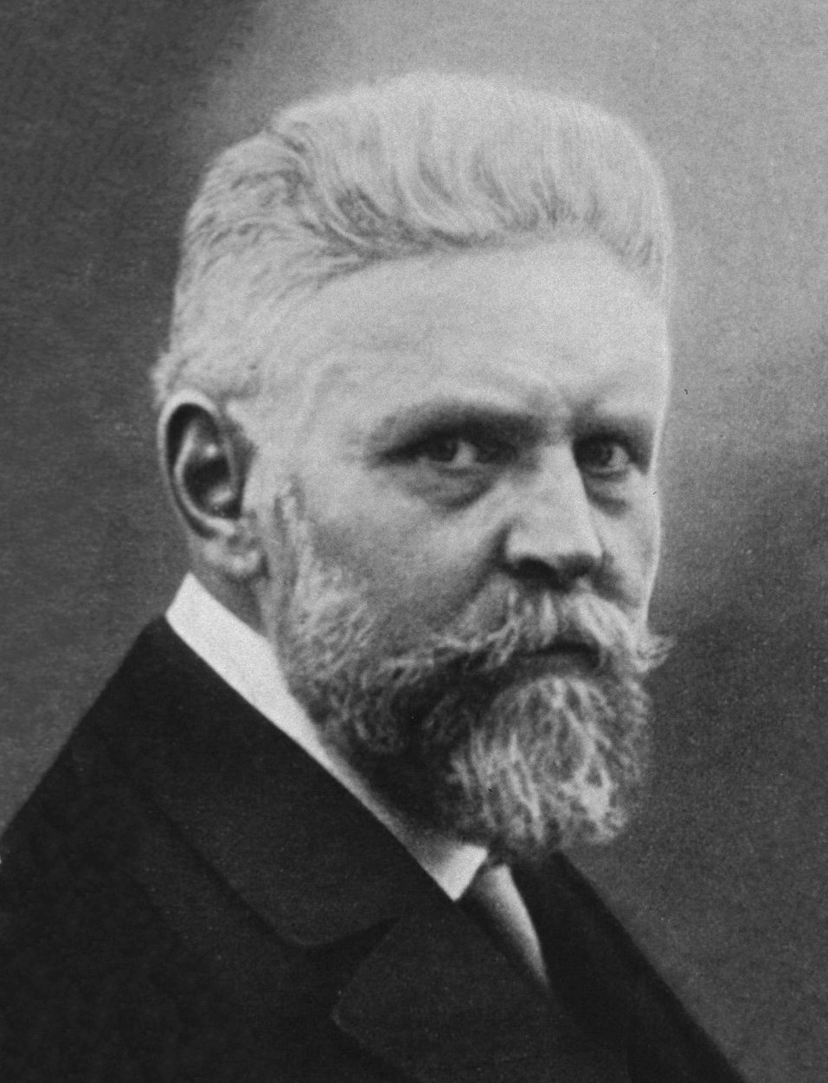
German Eugenics
Alfred Ploetz and Wilhelm Schallmayer serve as key figures
Rassenhygiene, Rassehygiene, or Eugenik?
German eugenics (at this point) remains confined to intellectual circles: Gesellschaft für Rassenhygiene
Debate on institutionalized eugenics- sterilization, marriage passports, etc.
Abortion as a collective concern
The superiority of the Nordic Race and antisemitism

Slide 4
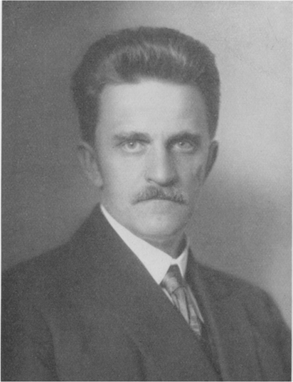
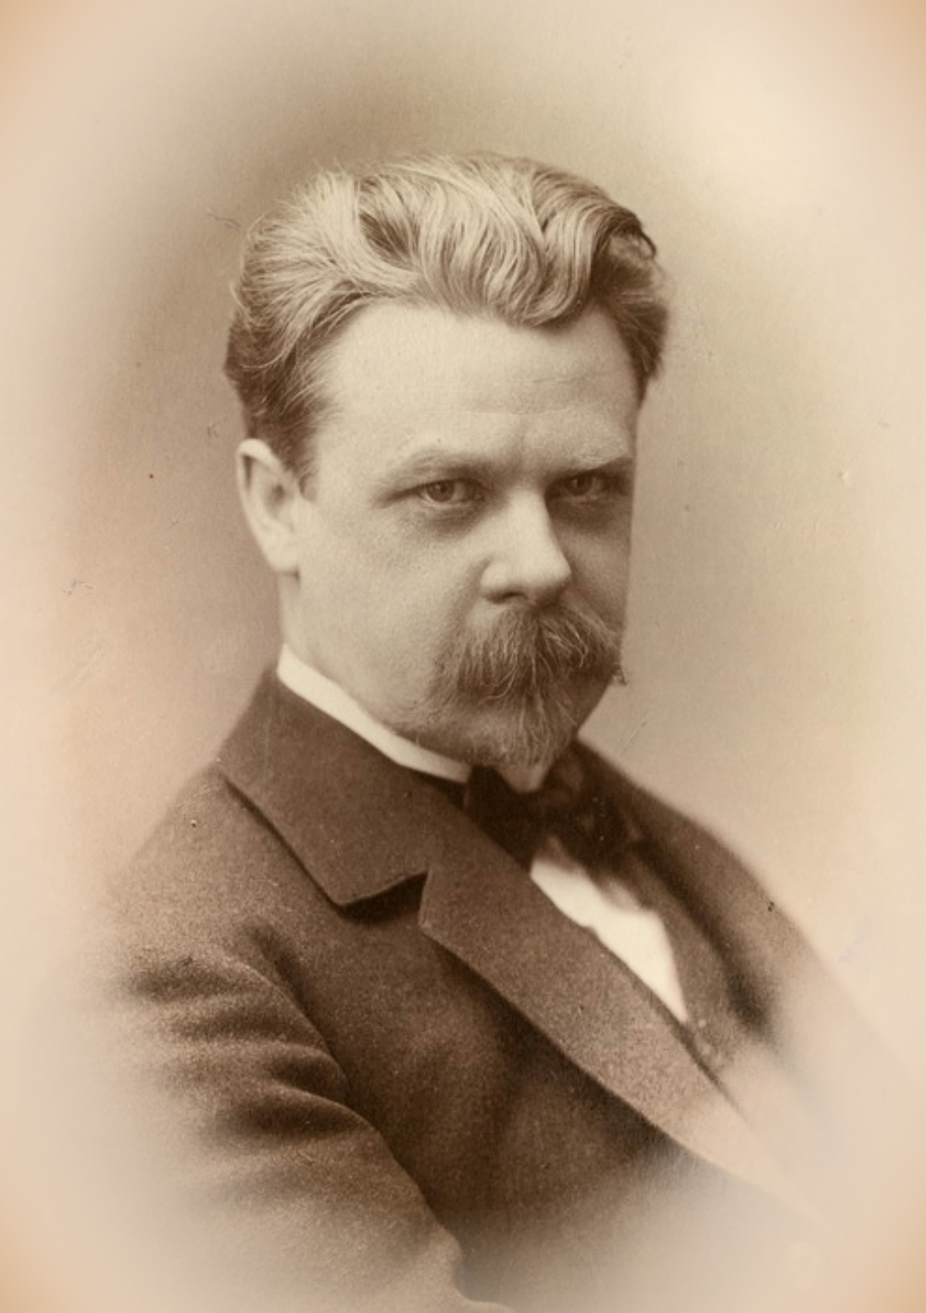
Bolshevik Eugenics
Led by Nikolai Koltsov and Iurii Filipchenko- creation of the Institute for Experimental Biology
Much more focused on propaganda/educating the public
Strong connections with negative eugenicists in the West (Charles Davenport), but are hesitant to adopt a full American model
1926 Civil Code introduces marriage restrictions and the keeping of genetic records
Lamarckian approach preferred, but rejected because the proletariat then have acquired the bad traits of their pre-revolutionary ancestors
Embrace of Positive Eugenics through insemination

Slide 5
A Note on Eugenics under Stalin
After the Great Break, Eugenic societies in the Soviet Union attempted to regroup multiple times, having been accused of bourgeoisie activity. However, they were never able to fully recover, especially after Stalin’s support of Lysenko.
After the start of the Second World War, eugenics was denounced as the basis for Hitler’s power, and further considered a movement that went against the state.
Despite their opposition to American practices, many of the eugenicists who are able to leave the country emigrate to the United States and continue their research at the Carnegie Institute under Davenport

Slide 6
Conclusion
In both countries, eugenics began as a leftist movement, though their goals differ.
Race played a prominent role in German eugenics, but was not a prominent factor for the Soviets
The Soviet case, in particular, has an interesting outcome, since many of the influences and practices were negative from eugenics in the United States and Britain, but a negative model of eugenics is not adopted.

Slide 7
Sources
Adams, Mark B. “Eugenics in Russia, 1900-1940.” In The Wellborn Science: Eugenics in Germany, France, Brazil and Russia, edited by Mark B. Adams, 153–216. New York, NY: Oxford University Press, 1990.
Graham, Loren R. “Science and Values: The Eugenics Movement in Germany and Russia in the 1920s.” The American Historical Review 82, no. 5 (1977): 1133–64. https://doi.org/10.2307/1856342.
Krementsov, Nikolai “From ‘Beastly Philosophy’ to Medical Genetics: Eugenics in Russia and the Soviet Union.” Annals of Science, 68, no. 1 (2011): 61-92, DOI: 10.1080/00033790.2010.527162.
Weiss, Sheila Faith. “The Race Hygiene Movement in Germany, 1905-1945.” In The Wellborn Science: Eugenics in Germany, France, Brazil and Russia, edited by Mark B. Adams, 8–68. New York, NY: Oxford University Press, 1990.

