Slide 1
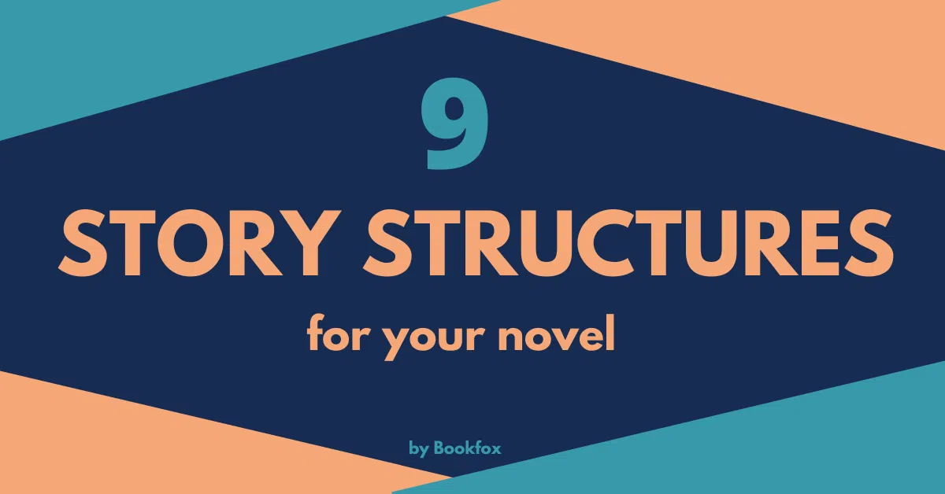

Slide 2
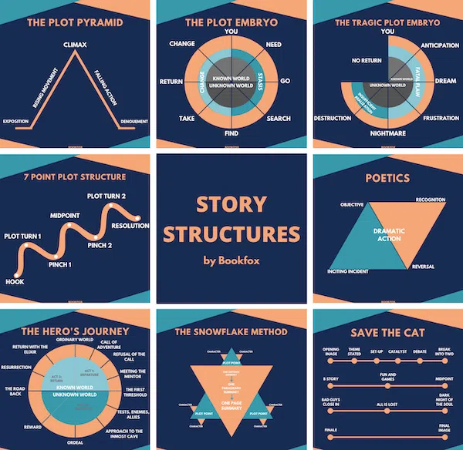
A story structure is basically a map to keep you from getting lost as you set off into the unknown. It identifies the key elements of dramatic plot in any story. Once you know the path, you can chart your course and then play in the blank space from Point A to Point B.
Narrative structure and plotting systems come in many forms, some more complex than others. These 9 story structures range from the classic plot pyramid to the lesser-known plot embryo to Aristotle’s ancient Poetics, but they’re all trying to answer the same questions:
What makes up a story?
What kind of stories please the reader?
What is it about a beginning, middle, and end that makes a plot really sing?

Slide 3
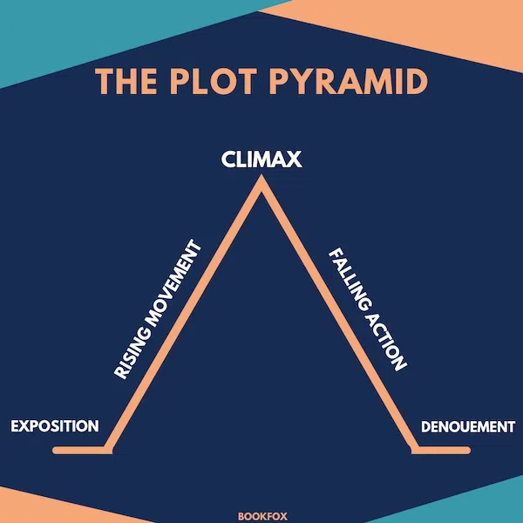
STORY STRUCTURE OF THE PLOT PYRAMID
Exposition: The beginning of the story sets up the main character(s) and setting. We get background information, just enough to get us started with the story. Everything is status quo.
Rising movement: The conflict begins. Suspense and tension rise, the plot picks up, and the reader is wondering what’s going to happen. How will our main character get out of this? How will they win?
Climax: Maximum suspense. This is the peak of the conflict and a turning point for the main character.
Falling action: The conflict unravels, pieces fall into place, our main character has the key to victory, and eventually we reach a resolution to the conflict.
Denouement: Outcome or conclusion. The conflict is resolved, the main character has won, and the story is over.

Slide 4
THE PLOT PYRAMID IN ACTION
To illustrate Freytag’s plot pyramid in action with a story you already know, let’s go through Harry Potter and the Sorcerer’s Stone.
Exposition: Harry is an orphan living in a cupboard under the stairs in the home of his abusive aunt and uncle. He feels odd and out of place.
Rising movement: Harry finds out he is a wizard and attends Hogwarts School of Witchcraft and Wizardry. He goes to class, makes friends like Ron and Hermione, makes enemies like Malfoy and Snape, and he learns about Voldemort, the evil wizard who killed his parents. He also learns that the sorcerer’s stone is hidden and guarded in the castle.
Climax: Harry decides to go after the stone to keep Snape from stealing it.
Falling action: Harry and his friends pass through trials guarding the stone. Harry meets Voldemort, and because he is pure of heart, he beats Voldemort and escapes with the stone.
Denouement: Harry recovers. He heroically wins the house cup and feels fully accepted at Hogwarts.

Slide 5
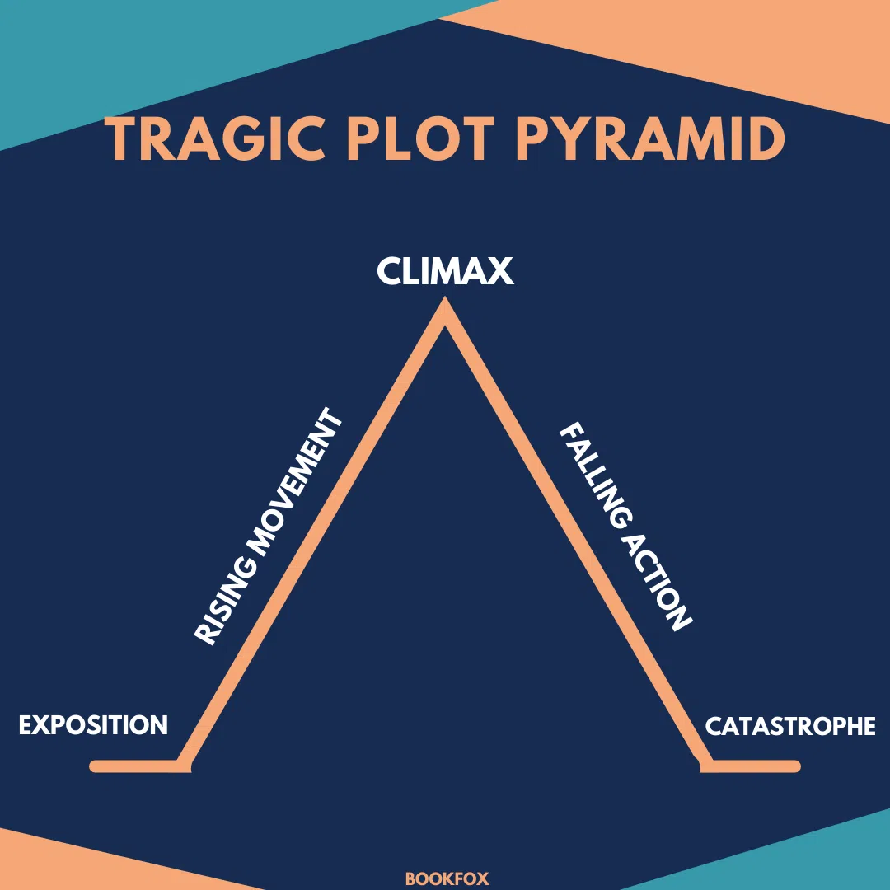
What happens if your main character is an anti-hero? Or a straight-up villain?
As it turns out, Freytag’s original plot pyramid was designed with tragedy in mind. This explains why the climax is in the middle of Freytag’s original pyramid, instead of being closer to the end.
The version we know, which includes “denouement” and allows for a happy ending, isn’t in Freytag’s original writing. Instead, Freytag’s last step in his plot structure is “catastrophe.” As you might be able to guess, that’s when everything goes wrong and or protagonist meets their tragic end.

Slide 6
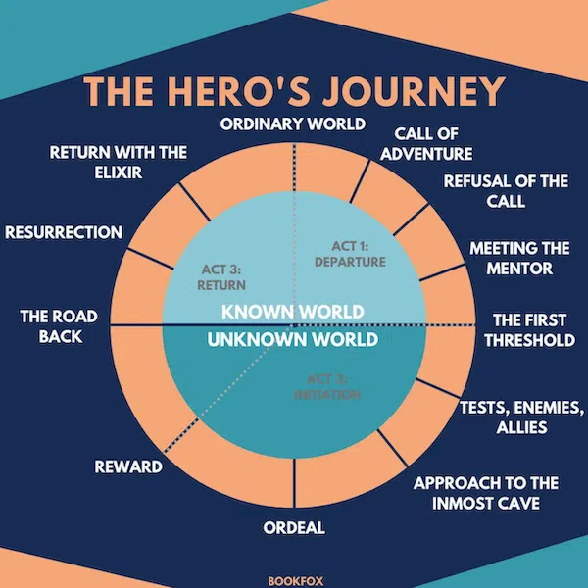
Devised by Joseph Cambell in his study of folklore.
STORY STRUCTURE OF THE HERO’S JOURNEY
The Ordinary World: This is pretty similar to “exposition” in the plot pyramid. Here, we see the status quo. The audience meets the hero, and we see how the world is for them before the story really gets going.
The Call of Adventure: This is sometimes called the “inciting incident.” Something happens that rocks the hero’s world, and they can choose to go on an adventure. Or, sometimes, adventure chooses them. Either way, the hero gets their first idea of leaving what is comfortable.
Refusal of the Call: The hero experiences some hesitation. This can be an outright refusal of the call of adventure, and they can change their mind when the stakes are raised. Alternatively, this can be a moment when a hero feels reluctant but knows they must leave home anyway.
Meeting the Mentor: Someone helps the hero on their journey. They act as a guide to get the hero started and give them an extra nudge of help. Think “wise old wizard,” or a similar character type.
Crossing the First Threshold: The hero crosses the threshold from the Known World into the Unknown World, and they fully begin their adventure. Now that they’re in a new world, they realize that nothing will ever be the same again.
Tests, Allies, Enemies: Now, we get to meet some fun new characters that exist in the world of the Unknown. We’ll have allies to hep the hero, enemies to stand in their way, and obstacles to overcome.

Slide 7
7. Approach to the Inmost Cave: The “inmost cave” is the purpose for venturing into the Unknown World. It’s as far into the Unknown as the hero needs to go, and the hero is almost there. Suspense!
8. The Ordeal: The hero must face their biggest fear. They’re in their worst situation yet, and this dark moment changes everything. Or at least, it changes the way the hero sees everything.
9. Reward: The hero finds what they’ve been seeking. This is the key to getting what they really want. Also called “seizing the sword,” the hero gets ahold of the crucial tool that they’ll need for the rest of the story.
10. The Road Back: Crossing the threshold back into to the Known World, the hero must face more obstacles than they expected. Some unforeseen tough trials and tests still stand in their way.
11. Resurrection: This is the climax. The moment we’ve all been waiting for. Maybe it’s a near death experience (hence “resurrection”) or maybe the hero simply leaves the encounter forever changed, as if they’re a new person.
12. Return With the Elixir: Finally victorious, the hero is home again. We’re back where we started, but the hero has grown and changed, so everything feels different.

Slide 8
THE HERO JOURNEY IN ACTION
Ordinary World: Harry is an orphan living with the Dursleys in a cupboard under the stairs.
Call to Adventure: Mysterious letters arrive via owl, all addressed to Harry.
Refusal of the Call: The Dursleys try to keep Harry from opening his letters, going so far as bringing him out to a shack on a rock in the middle of the sea.
Meeting the Mentor: Hagrid appears in the shack and tells Harry he’s a wizard. He takes him to Diagon Alley to get him everything he needs.
Crossing the Threshold: Harry takes the Hogwarts Express to arrive at Hogwarts.
Tests, Allies, Enemies: Harry faces tests in the form of his classes, joining the Quidditch team, and taking down a runaway troll. He befriends Ron and Hermione, and he finds enemies in Draco Malfoy and Professor Snape.
Inmost Cave: Harry learns about the sorcerer’s stone and fears that Snape is trying to steal it. Because of this, Harry feels a threat to the world he has come to love.
8. Ordeal: Harry, Ron, and Hermione face a series of trials to get to the stone before Snape can steal it. Harry enters the final test alone and discovers that Quirrell has teamed up with Voldemort, and they’ve beaten him there.
9. Reward: Because he is pure of heart, Harry gets ahold of the stone.
10. Road Back: Harry resists Voldemort’s touch, and Voldemort is weakened.
11. Resurrection: Harry is rescued while unconscious and wakes up in the Hospital Wing. (Note that this step is abbreviated—Harry isn’t active in this step. It’s the first book in a series, so we can cut it some slack.)
12. Return With Elixir: Harry returns with the sorcerer’s stone, also known as the Elixir of Life. Once he’s healed, he is a hero for winning the house cup. He returns to the Dursleys forever changed.

Slide 9
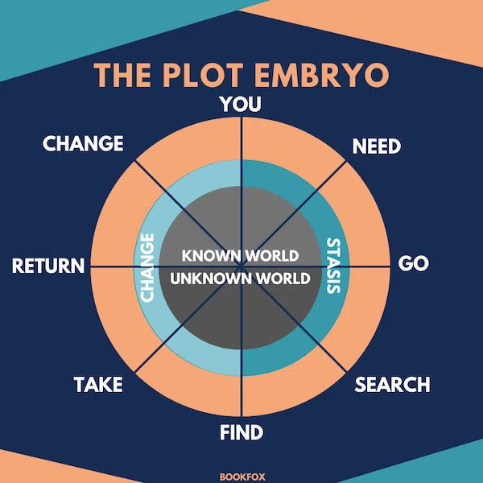
STORY STRUCTURE OF THE PLOT EMBRYO
You: Once again, we have the exposition where we establish our protagonist in the normal world.
Need: As Harmon says, “something ain’t quite right.” The motive appears, and our main character now has a goal.
Go: The protagonist crosses the first threshold from the Known to the Unknown World.
Search: Our character must face tests and trials to get the thing they need. As they do so, they’re forced to adapt, and our character might break down.
Find: At the bottom of the circle, this is once again a crucial, pivotal, vulnerable moment for our character. Here’s the big thing: they have to make a choice. In doing so, they pass over the threshold from Stasis/Ignorance to Change/Enlightenment.

Slide 10
STORY STRUCTURE OF THE PLOT EMBRYO
Take: There is a high price to pay. The protagonist experiences their lowest point, and they must make a sacrifice of some kind.
Return: Our character brings home what they set out to gain, and they cross back into the Known World.
Change: The main character has changed, and they can now create change in their home. The conflict is overcome once and for all.

Slide 11
THE PLOT EMBRYO IN ACTION
You: Harry is an orphan who lives in a cupboard under the stairs. He feels odd and out of place.
Need: Harry wants a sense of belonging. When he receives mysterious letters and finds out he is a wizard, he wants to learn all about this new world that he’s from but never knew about.
Go: He goes to Hogwarts and is sorted into Gryffindor.
Search: As he adapts to the wizarding world, Harry develops his character by finding friends (Ron and Hermione) and foes (Malfoy and Snape).
Find: Harry learns about the sorcerer’s stone. Learning this secret connects Harry more deeply to the wizarding world, and he realizes he wants to take action to protect it.
Take: Harry risks his life to protect the stone from Snape. He encounters Voldemort, but his pureness of heart lets him rescue the stone and weaken Voldemort.
Return: Harry makes it back to safety and wins the house cup to prove that he has fully earned his place in the wizarding world.
Change: Harry is a new person. As a result, life during the summer with the Dursleys will not be the same—he knows that he truly belongs at Hogwarts and that he has a real home.

Slide 12
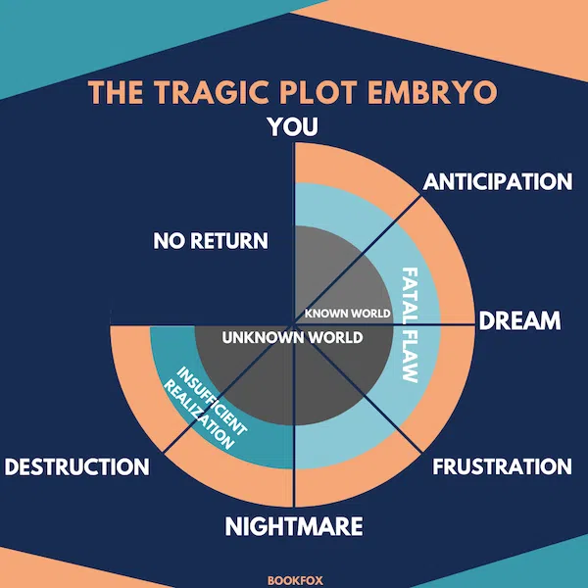
This version of the plot embryo has a lot to offer tragic heroes, villains, or antagonists. The tragic hero doesn’t finish the arc. The tragedy is that they are never able to “return” or “change.”
STORY STRUCTURE OF THE TRAGIC PLOT EMBRYO
You: Essentially the same as the regular plot embryo with an extra emphasis on the character’s backstory and what might have led them to gain their fatal flaw.
Anticipation: The main character wants something, and it’s informed by their backstory. We learn why they might want it, even if it’s morally wrong.
Dream: The character goes looking for what they want. In doing so, they have an opportunity to start making bad choices to get there.
Frustration: The conflict picks up, and the character must adapt in the face of the forces that oppose them.
Nightmare: Our character learns the “awful truth.” Maybe they get what they want, but it’s at too great a cost. This is a revelation, but instead of being changed, the character doubles down on their mistakes.
Destruction: The character pays the price, even though it’s too high. This price makes our character lose, and they end their story without success. They are never able to escape the Unknown World.

Slide 13
THE 7 POINT PLOT STRUCTURE
Hook: This is our starting point, and it should feel like the opposite of the ending. (A character starts weak and ends strong, for example.)
Plot turn 1: This is the call to adventure, the inciting incident. Something changes in the world of our character that gets the story going.
Pinch 1: A moment of conflict. The protagonist has to solve a problem. This is a moment for the author to apply pressure to their story—something goes wrong, and the character has to step up to the plate.
Midpoint: A switch from reaction to action. Kind of like the switch from Ignorance to Enlightenment in the Plot Embryo, this is a moment where our main character makes a choice to move actively toward the end of the story.

Slide 14
THE 7 POINT PLOT STRUCTURE
Pinch 2: Something bigger goes wrong, and the main character must adapt to the new situation. More pressure is applied. This can also be a dark “all is lost” type moment where the character faces “the jaws of defeat.”
Plot turn 2: Right when all might be lost, the character learns something crucial and/or gains the key to the resolution of the story. They now know how to win. It can be the moment where the character learns, “The power is in you!”
Resolution: Simply, this is where we end with our character now that they’ve changed and come out victorious. This should be the opposite of where they were in the beginning.

Slide 15
7 POINT PLOT STRUCTURE IN ACTION
Hook: Harry is an orphan living in a cupboard under the stairs.
Plot turn 1: Harry learns he is a wizard and goes to Hogwarts.
Pinch 1: Harry fights the troll and befriends Hermione and Ron.
Midpoint: Harry has an experience in the forest where he sees someone sucking blood from a dead unicorn. He learns what evil looks like and opposes it.
Pinch 2: When rescuing the stone, Ron and Hermione can’t pass all the tests, so Harry goes on alone.
Plot turn 2: Harry learns the truth about Quirrell. Because he is pure of heart, he gets the stone and learns he has an upper hand because Voldemort cannot touch him.
Resolution: Harry defeats Voldemort and becomes a hero at Hogwarts.

Slide 16
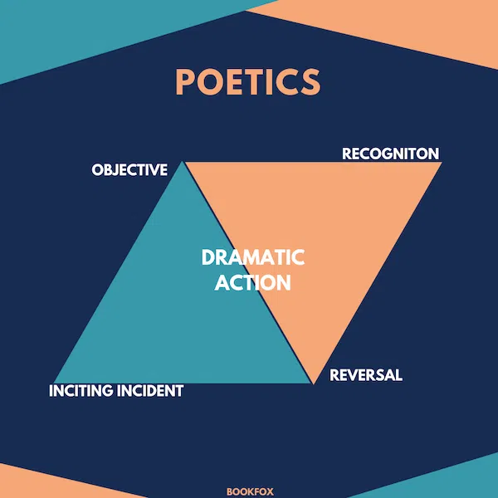
It comes from Aristotle’s poetics, written in 335 BC
STORY STRUCTURE OF POETICS
Dramatic action: This is made up of two parts: a character and what it is that they’re trying to do. For example, “Sarah tries to uncover the truth about her brother’s disappearance.” This is the central action that makes up the story.
Inciting incident: The catalyst, the kickoff point of the action of the story.
Super-objective: What a character wants most of all in the story. If we’re talking about the main character, this can be the same as the dramatic action.
Objective: What a character wants, scene by scene. A character will likely have many objectives throughout a story, and each one will help them get to their super-objective. To continue with our earlier example, Sarah’s objective in a scene might be to persuade her aunt to have lunch with her… because she thinks her aunt might know something about her brother.

Slide 17
Recognition: A moment near the end of the plot when a character encounters some enlightening information that changes everything. A common tragic example is from Oedipus Rex, when Oedipus discovers that he has killed his father and married his mother.
Reversal: As a result of the recognition, the character makes a choice. This is the very end of the story, and the main character either achieves their super-objective or doesn’t. Oedipus, after learning the truth, blinds himself.

Slide 18
POETICS IN ACTION
Dramatic action: Harry Potter protects his newfound home. (This could also be Harry’s super-objective.)
Inciting incident: Harry discovers he is a wizard and attends Hogwarts.
Objective: On Halloween, Harry’s objective is to make sure Hermione is alright. (To accomplish this, he and Ron find her hiding in the bathroom and fight a troll to protect her.)
Recognition: Harry learns that the person after the stone wasn’t Snape, it was Quirrell in cahoots with Voldemort.
Reversal: Harry is in a much bigger showdown than he expected. Harry’s takes the stone himself because he is pure of heart. He resists Voldemort’s attack and escapes, victorious.

